Slide 1
ROTARY SCHOLARSHIPS
Notes:
This presentation will provide an overview of Rotary scholarships.

Slide 2
OBJECTIVES
Types of scholarships
Setting and establishing timelines
Communication with sponsors & scholars
Identifying scholar candidates
Preparing for scholar departure
Setting and communicating reporting requirements
Notes:
By the end of this session you will know more about:
Types of scholarships
Setting and establishing timelines
Communication with sponsors & scholars
Identifying scholar candidates
Preparing for scholar departure
Setting and communicating reporting requirements

Slide 3
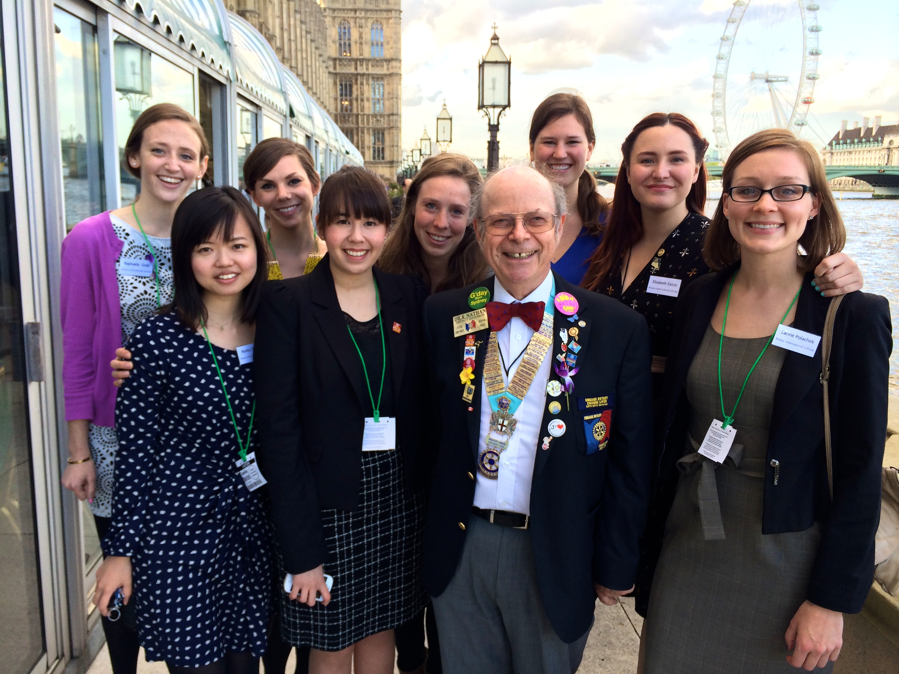
TYPES OF SCHOLARSHIPS
Global grants
District grants
Notes:
The Rotary Foundation supports scholarships through global grants and district grants.

Slide 4
GLOBAL GRANTS
Graduate-level
Study period 1-4 years
Alignment with the areas of focus
$30,000 minimum budget
Host and international sponsors
Notes:
Let’s first talk about global grant scholarships.
Global grants support scholarships for graduate students studying abroad in one of the six areas of focus. Scholarships range from one to four years and can include an entire degree program. Prospective scholars must show proof of admission to the chosen university before the grant will be approved. Global grant scholarships are funded using cash and/or the District Designated Fund, matched by the World Fund. The global grant budget must total at least US$30,000, but a scholarship may be a component of a larger grant application — for example, a scholarship plus a humanitarian project. All global grant projects, including scholarships, are sponsored by a club or district in the host (study) country and a club or district outside of the host country.

Slide 5
DISTRICT GRANTS
Flexibility with
Level of study (secondary, university, graduate studies or certificate programs)
Location (local or international)
Length of study
Area of study
Cost
Managed by district
Notes:
Now let’s move to district grant scholarships. There is a lot of flexibility with this type of scholarship.
District grants can be used to sponsor secondary school, undergraduate, or graduate students studying any subject, either locally or abroad. In addition, the scholarship may cover any length of time — from a six-week language training program to a year or more of university study. Districts may ask scholars to make presentations to local Rotary clubs and participate in Rotary service projects, but such involvement is not required by the Foundation.
The district is responsible for all administrative support for district grant scholars. No host counselor is provided for international district grant scholars. Districts may request assistance from Rotarians in the area where the scholar will be studying, but those clubs are under no obligation to act as hosts. It is recommended that districts appoint a scholarships subcommittee chair to manage the logistics of identifying and approving candidates, making payments, and coordinating with the district in which the scholar will be studying.

Slide 6
SETTING AND ESTABLISHING TIMELINES
Global grants
Accepted on rolling basis
Application submitted at least 3 months before study start date
District grants
Part of the spending plan
Notes:
Now let’s move to how best to set and establish timelines for clubs and districts so you can best support scholars in your area. First, there are TRF timeline requirements to note.
Global grant applications are accepted on a rolling basis throughout the year, but for grants involving travel such as scholars or vocational training teams, the application must be submitted to TRF at least three months prior to the study start date.
District grant scholars are included as part of the spending plan for the block district grant application. The district grant application can be submitted anytime before 15 May for the program year in question. Therefore, you want to make sure that the district grant application has been approved and ideally paid prior to the scholar starting their studies or travel.
These are the timelines put in place by TRF, but we encourage club and district leadership to work together to set their own internal deadlines as best suits the goals and schedules of your area.

Slide 7
SETTING AND ESTABLISHING TIMELINES
Month | Activity
January | Club and district leaders agree on internal procedures (application cycle, communication) Publicize opportunities (internally and externally)
February | Clubs and districts recruit outbound scholars Connect with partners about inbound scholars
March | Clubs and districts interview candidates Make preliminary decisions about which candidates to support and waitlist
April | Clubs inform district of candidates and ask for district support (including DDF, if desired)
May | Clubs and districts make final decisions about which candidates to support and waitlist Submit global grant applications online
June | Ongoing application submission, review, approval
July | Earliest that a 2014-15 scholar could receive payment
Notes:
If you wish, your club and district leadership can agree to have an internal business cycle by which to accept and support scholar candidates, whether inbound or outbound. This is not a TRF requirement and the example we provide here is only a launching point for discussion. Here we have the conversation beginning in January 2014 for the 2014-15 Rotary year.
Club and district timelines don’t have to necessarily align but it’s good to be aware of what everyone’s requiring, if anything. It is generally good practice to keep each other informed on any internal timelines you set. As with all areas, good communication amongst clubs and district is key.

Slide 8
COMMUNICATION WITH SPONSORS AND SCHOLARS
Setting expectations with sponsors & scholars
Club & district priorities for scholar types
Possible approval/denial by TRF
Scholar waitlist
Do not wish or are not able to support scholar
Notification of selected district grant scholars
Notes:
Generally, it is helpful to set expectations with sponsors and scholars prior to the application process. For example, does your club or district have any priorities on the types of scholars you would like to host or send as outbound scholars? Maybe your area is strong in one particular area of focus, and you would like to promote this. Or, alternatively, maybe you would like to send and receive scholars in a mix of different specialties. This is really up to clubs and district to decide and then communicate as needed with potential sponsors and scholar candidates.
It’s also important to clearly communicate the possibility of a scholarship not being sponsored by your area, or not being approved by TRF.

Slide 9
IDENTIFYING SCHOLAR CANDIDATES
Partnership with local universities
NGOs (Habitat for Humanity, Americorps Vista, etc)
Establish and support an Alumni Association
Utilize returning scholars as recruiters
Notes:
Now that you’ve set procedures for communication and timelines, the next step is identifying scholar candidates. Here are some strategies that you can use to find and recruit scholar candidates:
Create partnerships with local universities
Ask non-governmental organizations
Establish and support an alumni association
Use returning scholars as recruiters
At the club or district level, you will want to set your criteria for scholar selection. You might also want to create an internal application and interview process. If eligibility of a candidate is uncertain, contact Foundation staff. For global grants, provide the candidate with a copy of the grant terms and conditions and the area of focus policy statements and ensure that s/he understands them.

Slide 10
PREPARING FOR SCHOLAR DEPARTURE
Orientation for both GG & DG scholars
Scholar payment:
Setting payment expectations with sponsors
Completing online payment requirements
Authorizing the legal agreement
Paying scholar prior to departure
Notes:
Once you’ve identified scholars and their applications have been approved, it is your job as scholarship sponsors to prepare the scholar for departure. First, it is important to have a scholar orientation for not only global grant but also district grant scholars. This can be done in-person or as an online course, depending on preferences. This can be an incredible resource for scholars prior to their departure.
Secondly, we recommend setting payment expectations with sponsors and scholars at the very start of the application process, so that when it is approved, things can move as quickly as possible. Once an application is approved, the sponsors will need to provide bank signatory and account information in the online system. Depending on whether it is club or district sponsored, the Club President or DRFCC will need to authorize the legal agreement after application approval and prior to payment. This is also done within the online system. Payment to the scholar should be completed prior to departure so as not to put a financial burden on the scholar or Rotarian sponsors.

Slide 11
SETTING AND COMMUNICATING REPORTING REQUIREMENTS
Same financial documentation for both types
GG scholars:
Show alignment with area of focus
DG scholars:
Part of the overall district grant report
District can include additional requirements
Overdue reporting can impact application approvals
Staying involved as alumni
Notes:
As our final point, let’s discuss setting and communicating reporting requirements.
For TRF requirements, the financial documentation is the same for global grant and district grant scholars. The club or district must keep copies of all receipts and bank statements related to the grant in accordance with the terms of qualification. For global grant scholars, the Foundation requires a copy of the bank statement showing that the funds were received and paid out. The global grant scholar must also provide a summary of research and show how their studies or research aligned with their area of focus. For district grant scholars, the report is part of the overall report for the district grant. Your district may wish to include additional reporting requirements for district grant scholars.
Remember that it’s important to stay up to date on reporting for scholarships. If your club or district has an overdue report, it will prevent you from submitting new applications.
Also, please encourage scholarship recipients to stay involved as Rotary alumni. More information about alumni is available on Rotary’s website.

Slide 12
RESOURCES
www.rotary.org/grants
Global Grant Scholarship Supplement
District Grant Scholarships Best Practices
Scholar orientation course in Rotary’s Learning Center
Areas of Focus Policy Statements
Local experts
TRF staff
Notes:
There are several resources that we have available relating to scholarships. There is documentation on Rotary’s website. We encourage you to reach out to your local leadership and experts for their input and guidance. The grants staff at TRF is also happy to help at any point throughout the process.

