Slide 1
Vision Statement
“Together, we see a world where people unite and take action to create lasting change—across the globe, in our communities,
and in ourselves”

Slide 2
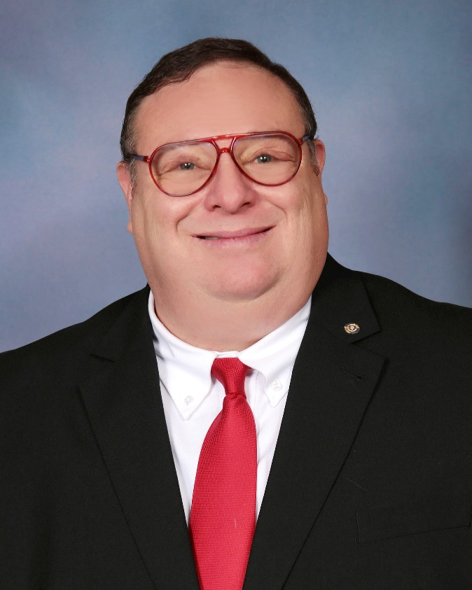
Marc Aarons
District Governor
Rotary District 5320
2019 - 2020

Slide 3
GRANT MANAGEMENT SEMINAR
DISTRICT 5320
March – April 2019

Slide 4
PURPOSE
Manage a Rotary grant
STEWARDSHIP expectations
Implementing the MOU
Qualify clubs to receive grant funds

Slide 5
GRANTS ARE FUNDED WITH “DDF”
District Designated Funds
Contributed to The Rotary Foundation Annual Fund 3 years ago
Current year contributions benefit the clubs
in 3 years
Invested by The Rotary Foundation
Returned to clubs in the form of grants

Slide 7
ROTARY FOUNDATION GRANTS
District grants
Global grants
Notes:
Speaking points:
Although this session will focus on applying for DISTRICT grants, the grant management practices discussed can be used for all grant types.
There are two types of Rotary grants available: district and global
For a district grant, clubs apply to the district, following guidelines developed by the district and the Trustees of the Foundation.
For global grants, clubs apply to The Rotary Foundation, following guidelines developed by the Trustees of the Foundation AND THEY WILL BE DISCUSSED LATER IN SESSION 5.

Slide 8
OVERVIEW OF ROTARY GRANTS
OVERVIEW OF ROTARY GRANTS
Decision-making power at the club and district levels
Two types:
global grants
district grants
Simplified leadership structures
Flexible DDF
Vocational training teams
Notes:
Speaking points:
The simplified leadership structure allows districts to create additional subcommittees and allocate tasks as appropriate.
Qualification allows districts the more cost-effective option of creating an internal audit committee rather than requiring an independent financial review.
Larger district grant activities are possible with the District Designated Fund (DDF).
Flexible scholarship requirements allow clubs and districts to fund scholars studying at various levels and in any amount.
Vocational training team guidelines allow clubs and districts to determine the size of the team and the amount of financial support to provide.

Slide 9
GRANTS – ROTARY 5320 STYLE!

Slide 10
District 5320 Global Grants – 19 countries
Guatemala Haiti United States-
India Ghana Fullerton
South Korea Korea – Wonju
Nigeria Nicaragua
Chile Egypt
Mozambique Peru
Mexico Kenya
Philippines Uganda
Cambodia Romania
Notes:
Speaking points:
The simplified leadership structure allows districts to create additional subcommittees and allocate tasks as appropriate.
Qualification allows districts the more cost-effective option of creating an internal audit committee rather than requiring an independent financial review.
Larger district grant activities are possible with the District Designated Fund (DDF).
Flexible scholarship requirements allow clubs and districts to fund scholars studying at various levels and in any amount.
Vocational training team guidelines allow clubs and districts to determine the size of the team and the amount of financial support to provide.

Slide 11
33 CLUBS have participated!
Anaheim Anaheim Hills Avalon Fountain Valley
Fullerton Fullerton Sunrise Garden Grove
Huntington Beach Irvine Laguna Beach Laguna Niguel
Lakewood Long Beach Los Alamitos/Seal Beach
Mission Viejo Monarch Beach Sunrise Newport-Balboa
Newport Beach Sunrise Newport-Irvine Orange
Orange North Orange Plaza Placentia San Clemente
San Clemente Sunrise San Juan Capistrano Santa Ana
Signal Hill Surf City/Huntington Beach Tustin/Santa Ana
Villa Park Whittier Sunrise Yorba Linda Sunrise
Notes:
Speaking points:
The simplified leadership structure allows districts to create additional subcommittees and allocate tasks as appropriate.
Qualification allows districts the more cost-effective option of creating an internal audit committee rather than requiring an independent financial review.
Larger district grant activities are possible with the District Designated Fund (DDF).
Flexible scholarship requirements allow clubs and districts to fund scholars studying at various levels and in any amount.
Vocational training team guidelines allow clubs and districts to determine the size of the team and the amount of financial support to provide.

Slide 12
APPROVED GLOBAL GRANTS – July 2016-February 2019
Maternal & Child Health Disease Prevention & Treatment
Mexico $ 81K Chile $ 63K
Uganda $103K Guatemala $ 70K
Peru $ 34K India $ 100K
India $100K Egypt $ 47K
Education & Literacy WATER AND SANITATION Korea $ 36K Guatemala $119K
Guatemala $694K India $102K
United States-Fullerton $ 35K Kenya $218K
Econ & Community Development Mozambique $190K
India $109K
Romania $ 53K
GRAND TOTAL - $3,039,000
Notes:
Speaking points:
The simplified leadership structure allows districts to create additional subcommittees and allocate tasks as appropriate.
Qualification allows districts the more cost-effective option of creating an internal audit committee rather than requiring an independent financial review.
Larger district grant activities are possible with the District Designated Fund (DDF).
Flexible scholarship requirements allow clubs and districts to fund scholars studying at various levels and in any amount.
Vocational training team guidelines allow clubs and districts to determine the size of the team and the amount of financial support to provide.

Slide 13
APPLYING FOR A DISTRICT GRANT

Slide 14
FIVE STEPS TO RECEIVING A DISTRICT MATCHING GRANT
STEP 1
Meet four club requirements
STEP 2
Complete a district grant application and prepare your project budget
STEP 3
Submit your application
STEP 4
STEP 5
Obtain electronic signatures
DG Committee reviews and approves your application and four requirements - grant funds are issued to your club!

Slide 15
Step One – Meet Club Requirements

Slide 16
FOUR CLUB REQUIREMENTS
These four requirements MUST be met in order for your club to be eligible for a district matching grant
Dues to Rotary International and District 5320 are current (July dues are paid)
Prior year district grant final report (or progress report) is filed by May 15; report with receipts have been posted to the matchinggrants.org website
Two club members have attended the most recent Grants Management Seminar
Your club must have signed a District or TRF Memorandum of Understanding (MOU) for local projects and a TRF MOU for projects in Mexico

Slide 17
Step Two – Complete Your Grant Application

Slide 18
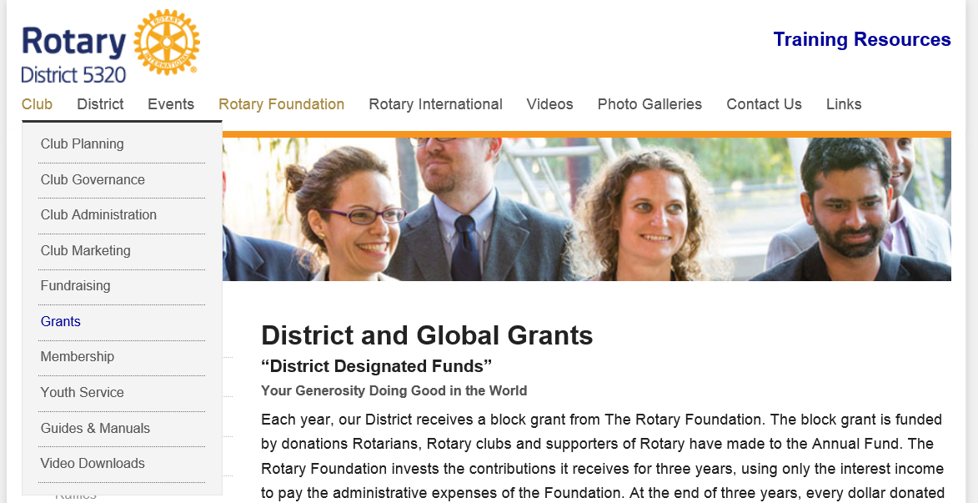
DISTRICT GRANT APPLICATION
Where can I find the form?
Go to rotaryresources.org
Within the “Club” tab, select “Grants”

Slide 19
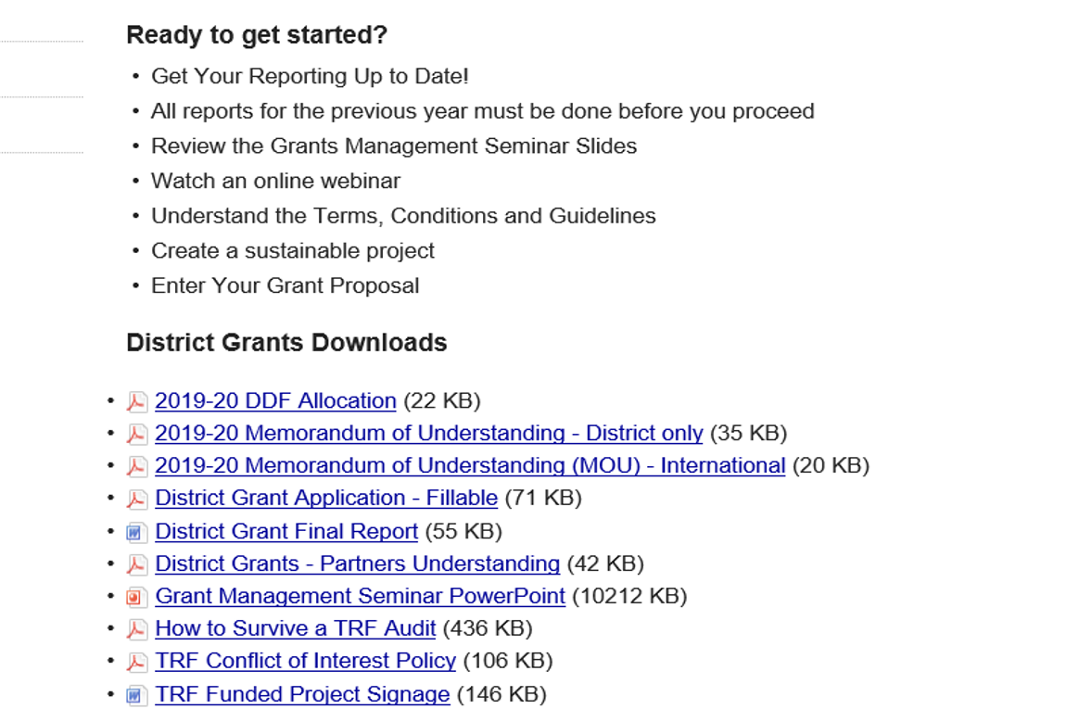
DISTRICT GRANT APPLICATION
Where can I find the form?
Scroll down to select “District Grant Application – Fillable”
Save the file to your computer. Open the file to fill out the application!

Slide 20
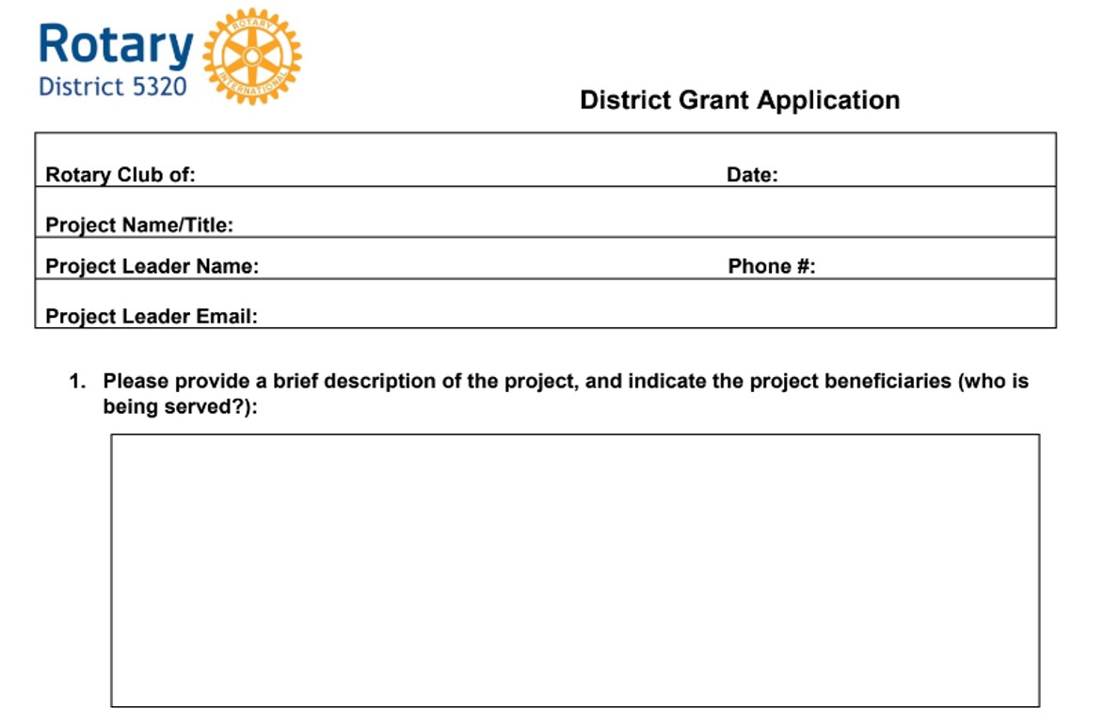
DISTRICT GRANT APPLICATION – Page 1
Correct
contact information is critical!
Be as specific as is necessary for the reviewer to understand the scope of the project
For example: “The project will provide backpacks filled with school supplies for 200 students in need, and our club will host an ice-cream social for the students and the teachers.”

Slide 21
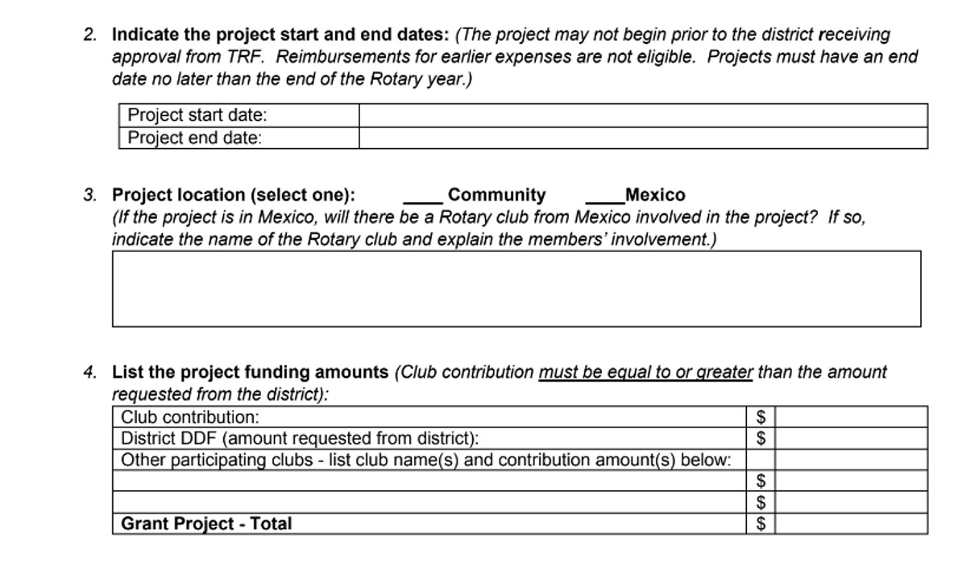
DISTRICT GRANT APPLICATION – Page 1 (continued)
Project must have a start and end date
Don’t forget
to complete
a “Partners Understanding” form if
working with another club

Slide 22
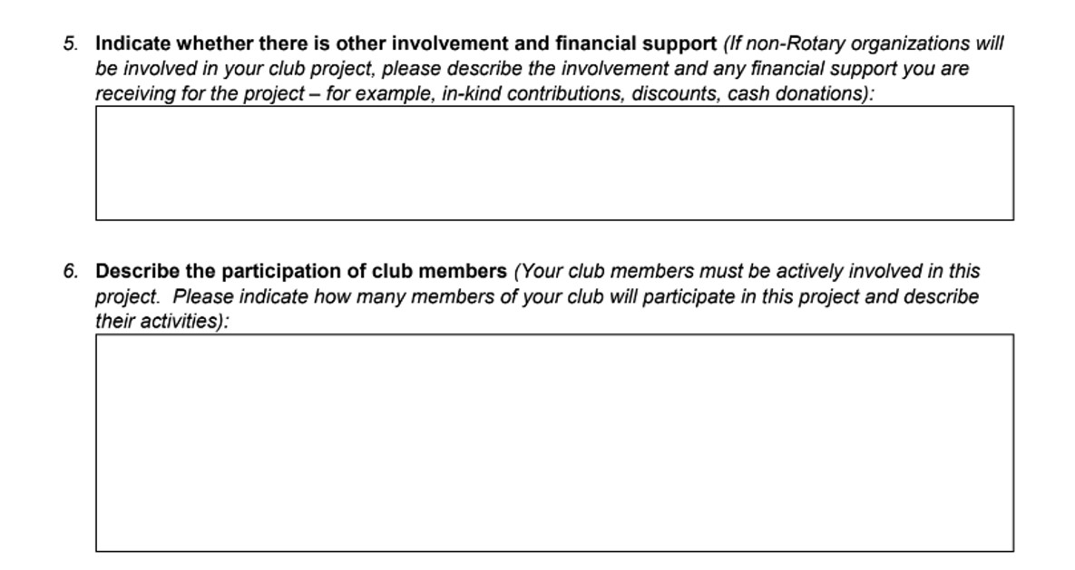
DISTRICT GRANT APPLICATION – Page 2
Type “n/a” if this section does not apply to your club’s project
For example: “Wells Fargo is donating $1,000 towards the purchase of backpacks.”
For example: “Approximately 20 club members will be involved in purchasing the backpacks and school supplies, filling the backpacks with the supplies, delivering/distributing the backpacks to local schools, and serving ice cream at the social.”
Detail the activities of
the project

Slide 23
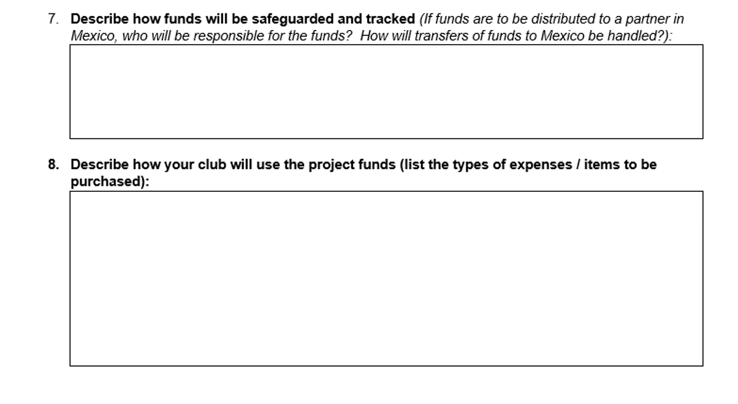
DISTRICT GRANT APPLICATION – Page 2 (continued)
Tip: Some clubs set up a separate account to manage district grant project funds
For example: “The funds will be maintained in our club’s checking account, and they will be tracked and disbursed by our treasurer in accordance with our club’s disbursement policies.”
This replaces the previous requirement for a separate budget!
For example: “All the project funds will be used to purchase backpacks, school supplies, and ice-cream for a social with the students and teachers.”

Slide 24
Step Three – Submit Your Application

Slide 25
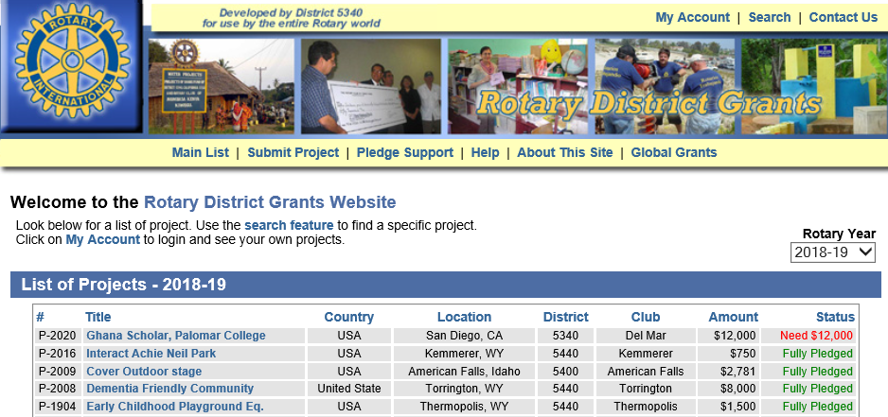
STARTING THE APPLICATION PROCESS
Where do I send my club’s district grant application?
Go to matchinggrants.org/district
Go to “Rotary Year” and ensure you select the correct Rotary year (2019-2020) in the dropdown menu
Click “Submit Project”

Slide 26
SUBMITTING A NEW PROJECT
You will see a new screen - Click “Submit a New Project”

Slide 27
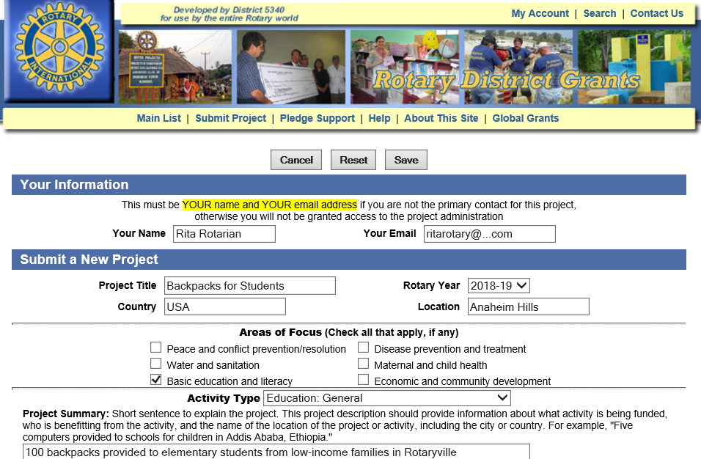
SUBMITTING A NEW PROJECT
You will see a new screen – Fill in each section requiring information
Select “2019-2020”

Slide 28
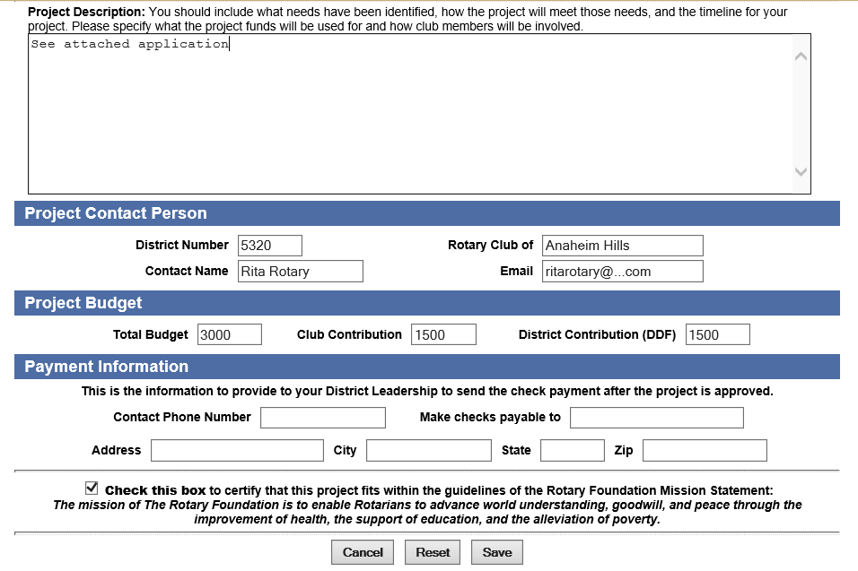
SUBMITTING A NEW PROJECT
Continue filling in information on this screen and click “save” when done
Just type “see attached application”
Amounts must match amounts in application

Slide 29
UPLOADING YOUR APPLICATION
This new screen will appear; click “administration” button
Click “administration” to
continue

Slide 30
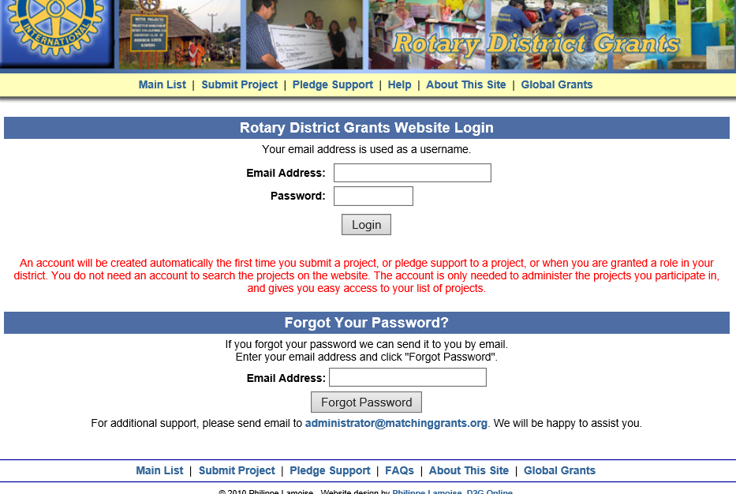
UPLOADING YOUR APPLICATION
This new screen will appear
Enter your email address and password; if you are a new user, your password will have been sent to you via email when you started the project

Slide 31
UPLOADING YOUR APPLICATION
On the page that opens, navigate to the “documents” tab to see this screen
Type a name for your file (“Grant Application”) and upload the file from your computer
Remember! Uploads must be in pdf format

Slide 32
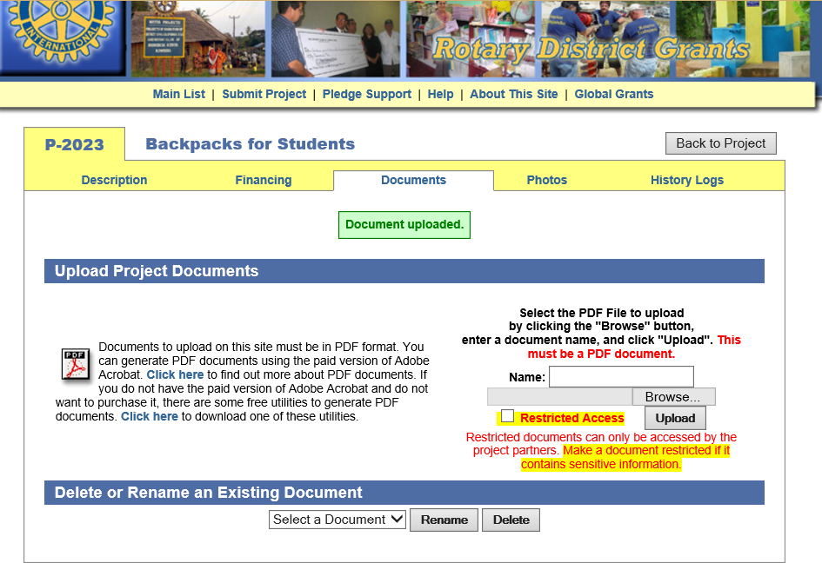
UPLOADING YOUR APPLICATION
Look for the upload confirmation
The “Document uploaded” message will appear

Slide 33
Step Four – Obtain Electronic Signatures

Slide 34
TWO ELECTRONIC SIGNATURES REPRESENTING YOUR CLUB ARE REQUIRED
Navigate to the “History Logs” page
Add a name and email address (club president is a good idea) so that there are at least two individuals from your club
Here, you should see your name & email address, along with those of the district grants committee members

Slide 35
START THE ELECTRONIC SIGNATURE PROCESS
Click the “Administration” tab to return to this page
Then click “Start Club Signature Process”

Slide 36
START THE ELECTRONIC SIGNATURE PROCESS
A new screen will appear
Click “Send Application for Signature”
The individual(s) you designated will then receive an email with instructions for approving the project via electronic signature

Slide 37
Step Five – District Approval of Project

Slide 38
DISTRICT COMMITTEE REVIEW PROCESS
When do we get our funds for the project?
The District Grants Committee will review your application for completeness, accuracy, etc.
The Grants Committee will ensure that your club has met the four requirements (payment of dues, completion of most recent district grant reporting, attendance at Grant Management Seminar, and submission of signed MOU)
Early July: Once your application has been approved, you will receive a message from the “Rotary District Grants Website” that your project is approved and you can begin your project
The grant check will be issued after the four requirements have been met

Slide 39
IMPORTANT DATES
Mark your calendar for these important dates
May 15 - Final or progress report is due for this year’s projects
June 15 - District Grant Application Deadline
June 15-30 - District Grants Committee Review of Applications
July 13-15 - Announcement of district grants to be awarded
After club receives approval notification (this year) to June 30 (next year)
- Projects must be started and completed during these dates

Slide 40
THANK YOU!

Slide 41
FINAL REPORTING
District 5320

Slide 42
DISTRICT GRANT FINAL REPORT
Where can I find the form?
Go to rotaryresources.org
Within the “Club” tab, select “Grants”

Slide 43
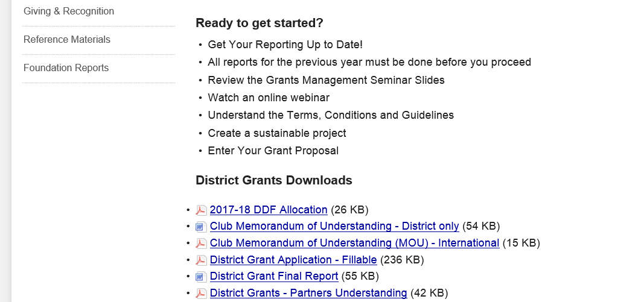
DISTRICT GRANT FINAL REPORT
Where can I find the form?
Scroll down to select “District Grant Final Report”
Save the file to your computer. Open the file to fill out the final report!

Slide 44
DISTRICT FINAL REPORT
Either a progress or final report must be filed by May 15
Please answer questions in detail!

Slide 45
DISTRICT FINAL REPORT (continued)
List each receipt on a separate line item. If you would like to group some expenses into a line item, prepare a sheet which shows how you added up the items!
Sign your report and don’t forget to save a copy
of your completed form in pdf. format

Slide 46
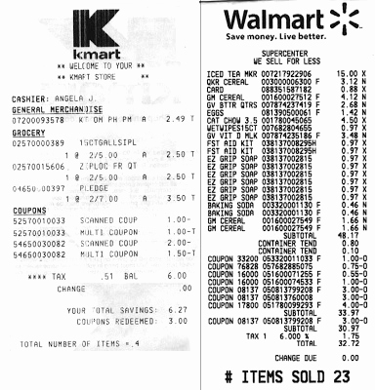
ASSEMBLE YOUR RECEIPTS
Scan your receipts into one pdf. file
Ensure that the receipt details are visible, and do not fold over portions of receipt
For receipts reported in Mexican pesos, please prepare a separate sheet with explanations of the items and the currency translation to USD

Slide 47
SUBMITTING YOUR FINAL REPORT AND RECEIPTS
You must submit a final or progress report along with copies of all project expenses by May 15 (e.g., projects for the 2018-2019 Rotary year need to be reported by May 15, 2019)
Go to matchinggrants.org, find your project, and navigate to the “administration” tab
Click the “documents” tab to see the screen below:

Slide 48
SUBMITTING YOUR FINAL REPORT AND RECEIPTS
Upload each document (report, scanned receipts, any other supporting document)
Documents need to be in pdf. format; the website will not accept Word, Excel, or any other document form

Slide 49
READY FOR REVIEW?
Once you are satisfied that you have uploaded all your final project documents, navigate to the “description” tab, and click “Reported”
The District Grant Committee will then review your documents and advise if anything else is required

Slide 50
QUALIFICATION AND STEWARDSHIP

Slide 51
QUALIFICATION REQUIREMENTS
Attend a Grant Management Seminar
2 Club Members
Submit signed club Memorandum of Understanding (MOU)

Slide 52
TERMS OF QUALIFICATION
Valid for one year
Club responsible for grant funds
Disclose conflicts of interest
Cooperate with all audits
Use grant funds properly
Implement the club MOU

Slide 53
MAINTAINING QUALIFICATION
Follow terms of club MOU
Appoint a club member or committee to manage club qualification
Fully implement stewardship practices to prevent misuse of funds

Slide 54
DISTRICT GRANT MOU SIGNING
WHO SHOULD SIGN THE DISTRICT MOU?
Clubs applying for a District Grant for a local community-based project only
District MOU must be signed by President Elect (2019-2020) and Project Chair

Slide 55
CONTACTS
District Rotary Foundation Committee Chair
Jim Paddock jpaddock1415@att.net
Grants Subcommittee Chair
Helen Maxwell helenrotary@2maxwells.com
District Grants Subcommittee Chair
Stacey Giannoulis rotarystacey@gmail.com
Global Grants Subcommittee Chair
International Service Chairs
John Perry jsprotary@gmail.com

Slide 56
BREAK

Slide 57
HOW TO CREATE A GLOBAL GRANT

Slide 58
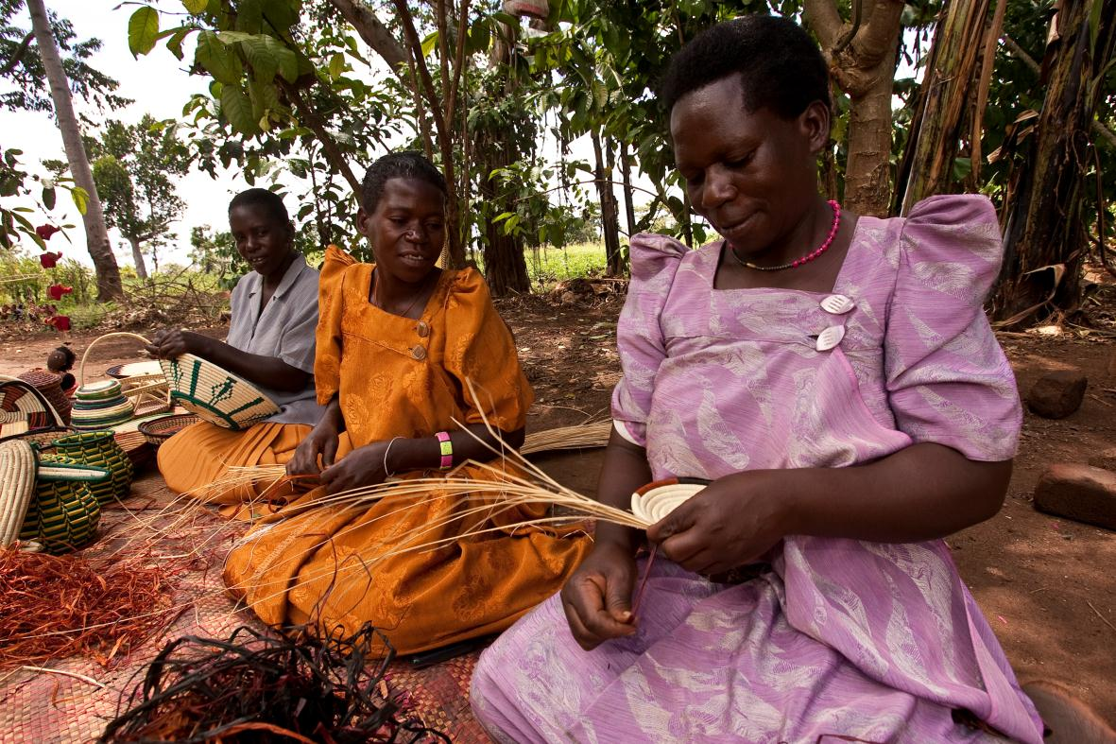
SUCCESSFUL ROTARY GRANTS
Community need
Sustainable
Partnership
Plan
Stewardship
Notes:
Speaking points:
Beneficiaries are more likely to support and participate in a project that addresses the needs of a community and has a sustainable outcome – one that will continue after the funds have been spent.
Rotarians should partner with the community and organizations with technical expertise; however, projects must be managed by Rotarians.
Working together means more than financial participation; it also means using each partner’s expertise to implement the project or activity.
The implementation plan should include an achievable project timeline and should be shared with partners and beneficiaries.
By establishing a financial management plan before applying for grants, clubs ensure that they will have processes in place to manage funds before any money is received.

Slide 59
COMMUNITY ASSESSMENT
A community assessment is required for all global grant applications
Assessment results submitted with online application
Examines community strengths, weaknesses, needs, assets
Notes:
Speaking points:
Asking members of the community what they need and what strengths they bring to the project results in greater support and involvement, which leads to a more sustainable, lasting impact.
Once the needs are identified, your club should consider which can be addressed with the resources, skills, and availability of your club and its potential partners, including other Rotary clubs, districts, The Rotary Foundation, and non-Rotary organizations.
Continue involving the community during the selection of the project and its planning and implementation.
The Rotary publications Communities in Action and Community Assessment Tools offer information and resources for conducting a community needs assessment.

Slide 60
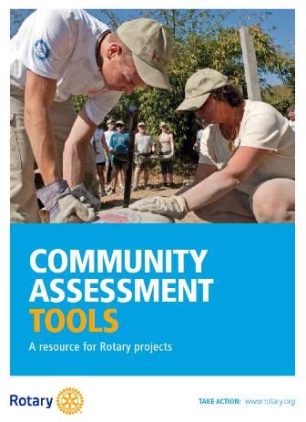
COMMUNITY ASSESSMENT BENEFITS
Increased understanding of community dynamics
Helps you make decisions about service priorities
Builds valuable relationships
Encourages community member participation
Helps to build trust, community ownership and sustainability
Notes:
Speaking points:
Asking members of the community what they need and what strengths they bring to the project results in greater support and involvement, which leads to a more sustainable, lasting impact.
Once the needs are identified, your club should consider which can be addressed with the resources, skills, and availability of your club and its potential partners, including other Rotary clubs, districts, The Rotary Foundation, and non-Rotary organizations.
Continue involving the community during the selection of the project and its planning and implementation.
The Rotary publications Communities in Action and Community Assessment Tools offer information and resources for conducting a community needs assessment.

Slide 61
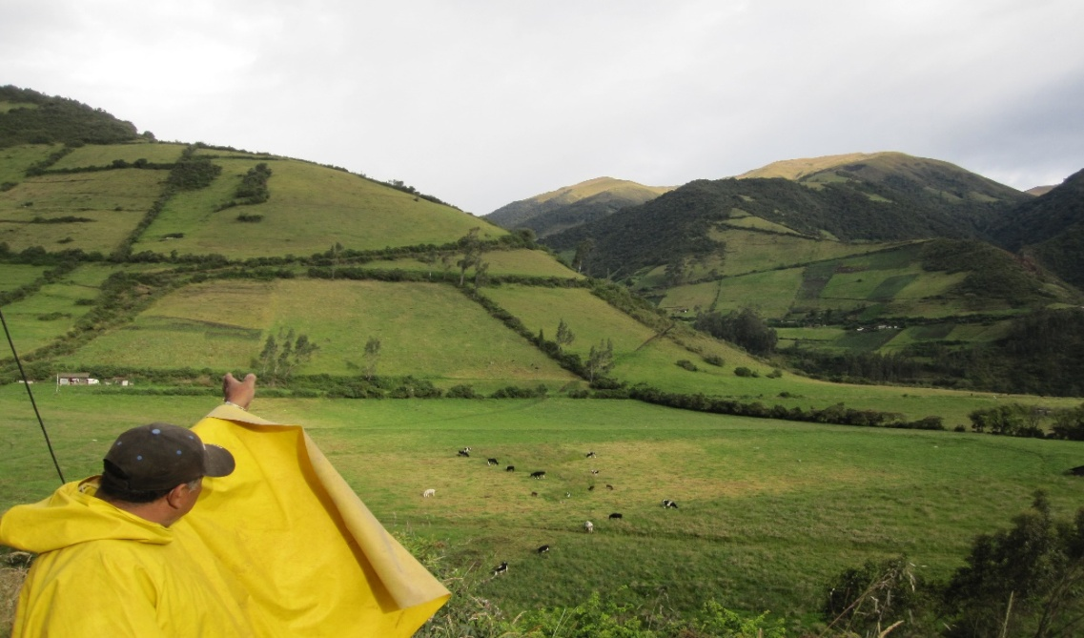
SUSTAINABILITY OF PROJECTS IS IMPORTANT FACTOR IN TRF CONSIDERATION
Giving a community the skills and knowledge to maintain project outcomes for the long term, after grant funds have been expended

Slide 64
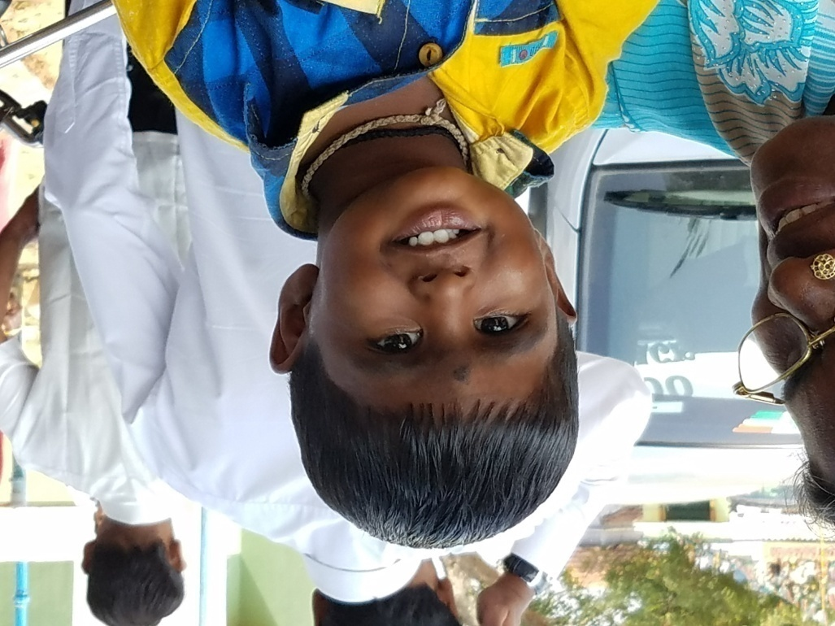
GLOBAL GRANTS
International partnership
Host Club
International Club
Measurable outcomes
Notes:
Global grants are sustainable, with measurable outcomes in Rotary’s areas of focus. A key feature of global grants is partnership, between the district or club where the activity is carried out and a district or club in another country. Both sponsors must be qualified before they can submit an application.

Slide 65
HOW TO FIND ROTARY PARTNERS FOR GLOBAL GRANTS
Rotary Convention
Project fairs
LinkedIn
Facebook
Rotary events
www.matchinggrants.org/global
www.rotary.org/rotaryideas

Slide 66
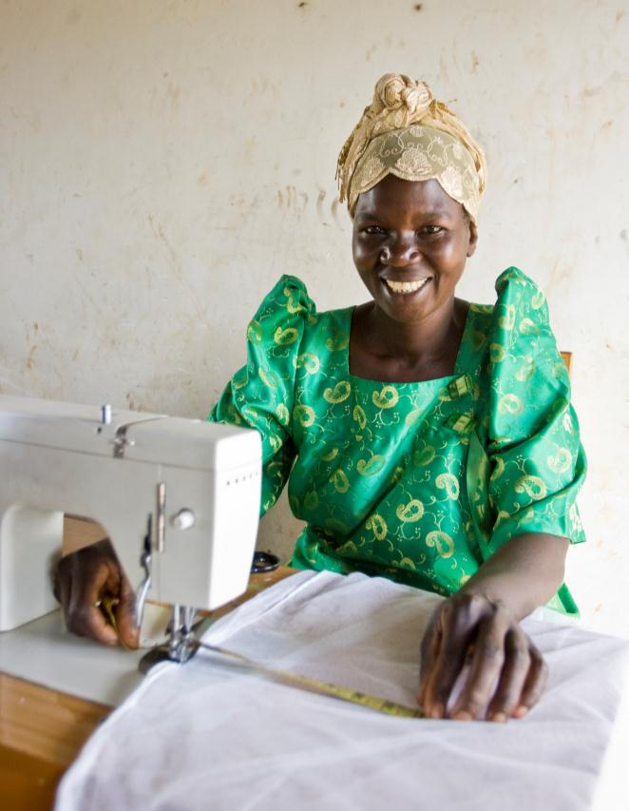
GLOBAL GRANTS
Are BIG!
$30,000 minimum
World Fund match
Minimum $15,000 in Rotary Foundation matching funds
Maximum $200,000
Align with an Area of Focus
Notes:
Global grants support large international activities.
The minimum budget for a global grant activity is $30,000. The Foundation’s World Fund provides a minimum of $15,000 and maximum of $200,000. Clubs and districts contribute District Designated Funds (DDF) and/or cash contributions that the World Fund matches. DDF is matched at 100% and cash is matched at 50%.

Slide 67
AREAS OF FOCUS
Disease prevention and treatment
Maternal and child health
Water and sanitation
Basic education and literacy
Economic and community development
Peace and conflict prevention/resolution
Notes:
We have identified specific causes to target to maximize our local and global impact. Through global grants we help clubs focus their service efforts in the following areas:
Peace and conflict prevention/resolution
Disease prevention and treatment
Water and sanitation
Maternal and child health
Basic education and literacy
Economic and community development

Slide 68
ROTARY FOUNDATION MATCHING FUNDS
Cash donations by Clubs
Matched 50% by TRF
District matches with DDF
1:1 up to $7,500 per club per year
District Designated Funds
Matched 100% by TRF

Slide 69
ROTARY FOUNDATION MATCHING FUNDS
Note:
5% must be added to club cash contributions sent to TRF for administrative costs
This can be avoided:
Send cash directly to project bank account
No Paul Harris credit
Must provide copy of bank statement to verify funding

Slide 70
ROTARY FOUNDATION MATCHING FUNDS
Example:
$10,000 Club(s) Cash
$ 7,500 District Designated Funds
TRF Match $12,500
$5,000 for Cash
$7,500 for DDF
Total Funds for project -- $30,000!
(Global Grant Calculator on District web site)

Slide 71
STEPS FOR MONITORING AND EVALUATION PLAN
Establish clear project goals.
Identify applicable Rotary Foundation standard measures.
Identify additional project‐specific measures.
Establish baseline data and the methods you’ll use to collect data.
Submit the plan as part of the online application.
Collect data during the project, and monitor progress.
Evaluate data and submit results to the online report.

Slide 72
EXAMPLES OF ROTARY FOUNDATION STANDARD MEASURES
Number of direct beneficiaries
Number of indirect beneficiaries
Number of people trained
Number of participants

Slide 73
EXAMPLES OF ROTARY FOUNDATION STANDARD MEASURES
Number of people receiving service
Number of events
Number of jobs created
Number of benefitting facilities
Number of communities with less conflict

Slide 74
BREAK

Slide 75
GLOBAL GRANT QUALIFICATIONS & RULES
MUST be up to date on all grant reports.
MUST have 2 club members at GMS.
MUST have a signed Memorandum of Understanding with TRF on file.
Signed by 2019-20 & 2020-21 presidents

Slide 76
FINANCING GUIDELINES
International sponsors must provide at least 30% of total sponsor funding
Funds cannot be raised from beneficiaries or cooperating organizations in exchange for a grant
Funds cannot come from other grants

Slide 77
GLOBAL GRANT QUALIFICATIONS & RULES
Each Club eligible for a total of $7,500 for Global Grants in District Designated Funds (DDF) for 2019-2020 Rotary year.
Club cash contributions are matched 1:1
up to this amount.

Slide 78
LETTER OF COMMITMENT
Letter of Commitment
To be Submitted by ALL Rotary Clubs contributing to a Global Grant
To: District 5320 and
Global Grants Program
The Rotary Foundation
The Rotary Club of __________________________ is pleased to commit funds in the amount $____________ in support of The Rotary Foundation Global Grant application identified as _______________________.
The source of funds for our commitment is:
$_________ General funds of the Rotary Club raised by member assessments or general fundraisers conducted by the Rotary Club
$_________ Contributions made by individual members of our Rotary Club or members of another Rotary Club and made payable to our Rotary Club, to our Rotary Club Charitable Foundation or to The Rotary Foundation that are designated for this Grant.
If a Rotarian or Rotary Club list name: ____________________________

Slide 79
LETTER OF COMMITMENT - continued
$_________ Contributions made by individuals from the general public and made payable to our Rotary Club, to our Rotary Club Charitable Foundation or to The Rotary Foundation that are designated for this Grant.
$_________ Contributions by entities (non-individual) supporters, including corporate sponsors, governmental agencies, non-Rotary foundations and other non-governmental organizations and made payable to our Rotary Club, to our Rotary Club Charitable Foundation or to The Rotary Foundation that are designated for this Grant.
These entities are listed below:
___________________________ $_____________________
___________________________ $_____________________
Sincerely,
President
Rotary Club of ____________________________ Date:____________________

Slide 80
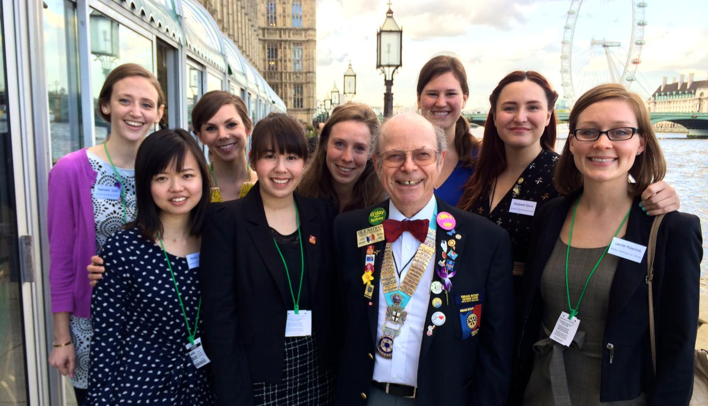
GLOBAL GRANT SCHOLARSHIP
Notes:
Rotarians in the US and the UK teamed up to provide a global grant scholarship to Reagan Thompson (center, back row) to receive a Master’s of Science (M.Sc.) degree in International Affairs with a Concentration in Conflict Prevention at the London School of Economics (LSE). Before beginning this program, she obtained a Master’s in Chinese Diplomacy at Peking University in China. She plans to pursue a career in government service focused on encouraging collaboration between the US and China. This grant falls within peace and conflict prevention/resolution area of focus.

Slide 81
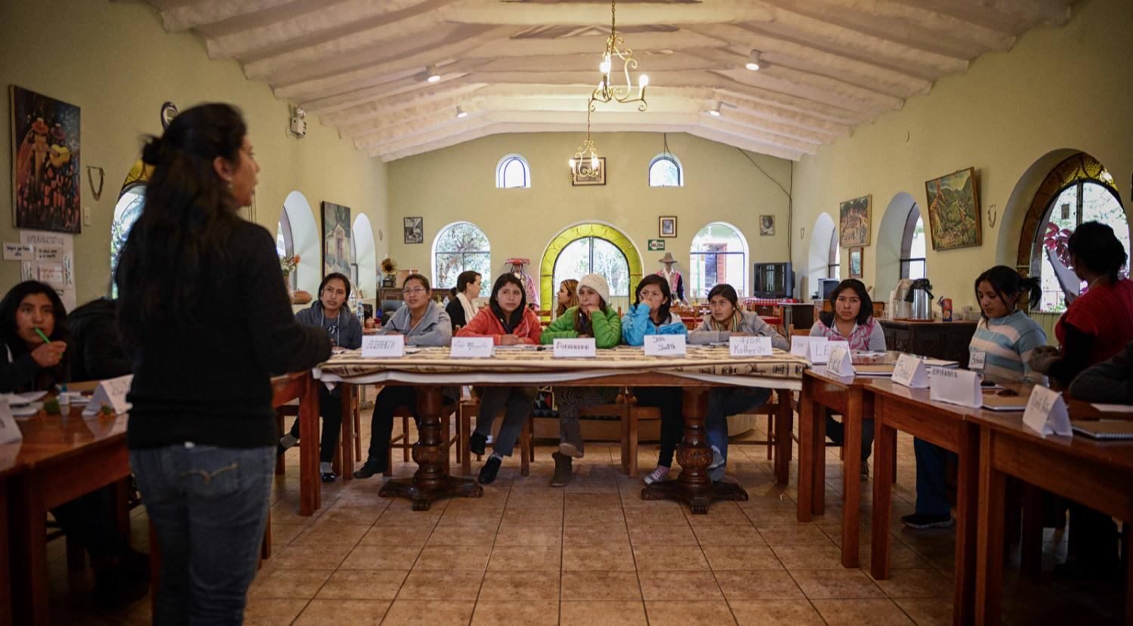
GLOBAL GRANT VOCATIONAL TRAINING TEAM
Notes:
Rotarians in Peru and the US worked together to get a global grant to support a leadership institute for young women in Peru. The goal of the program is to enhance the young Andean women’s self-awareness, leadership skills, and professional development to improve their opportunities to succeed academically and professionally. Secondly, the program engages the women to create their own visions for change and lead projects that deal with sustainable development initiatives appropriate for and desired by their families and communities. Rotarians from the US traveled to Peru to lend their professional expertise to the training sessions.

Slide 82
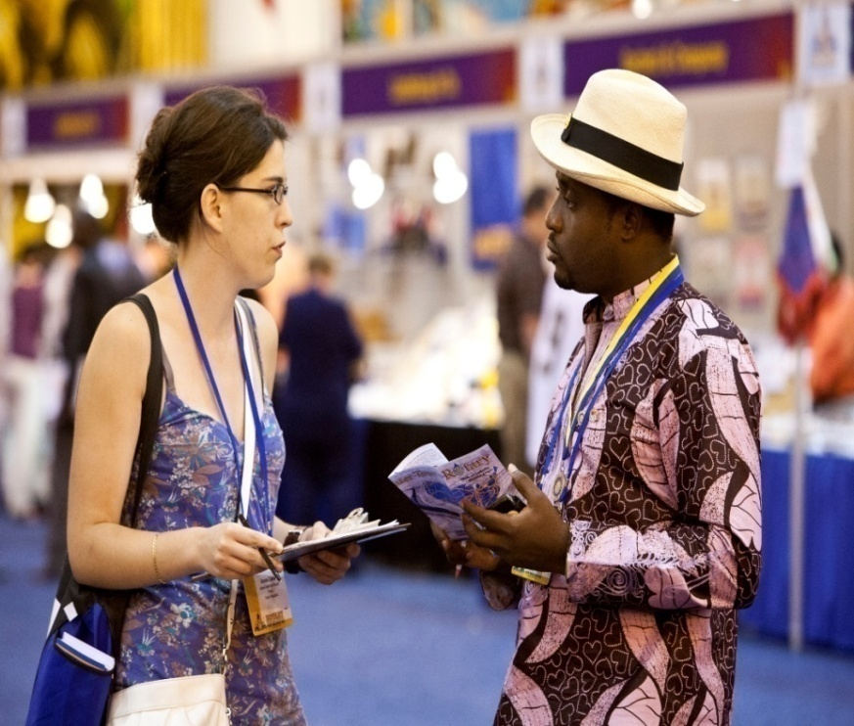
Grant Management
Ensures that projects
Have proper financial controls
Adhere to technical standards
Meet the needs of beneficiaries
Fulfill their objectives
Safeguard funds

Slide 83
Grant Documentation
All grant correspondence
Community assessment data
Cooperating organization documents
Vendor quotes/contracts
Agreements (esp. for scholars, VTTs)
All receipts/invoices
Bank statement
Inventory data
Photos
HAVE ALL AVAILABLE FOR INSPECTION AND KEEP FOR 5 YEARS

Slide 84
Reporting
Due every 12 months from initial funding date
Reminders sent
If late, your club cannot do any more grants!
Final report due 2 months after project completion

Slide 85
CHANGES EFFECTIVE 1/1/2018
Tax withholding for US-bound scholars
Low cost shelters and simple schools eligible for global grant funding
Notes:
Last fall the Trustees took two decisions that went into effect 1 January:
The Rotary Foundation will begin withholding tax from global grant scholarships awarded for study in the U.S. on any expenses beyond tuition, books, necessary equipment, and fees, except for U.S.-bound scholars from Japan, Canada, and Germany, who are funded through associate foundations in those countries.
Clubs and districts will be able to use global grants for the construction of low-cost shelters and simple schools, as long as the construction is part of a comprehensive project related to an area of focus. Project guidelines and application appendices for low cost shelters and simple schools are available on rotary.org.

Slide 86
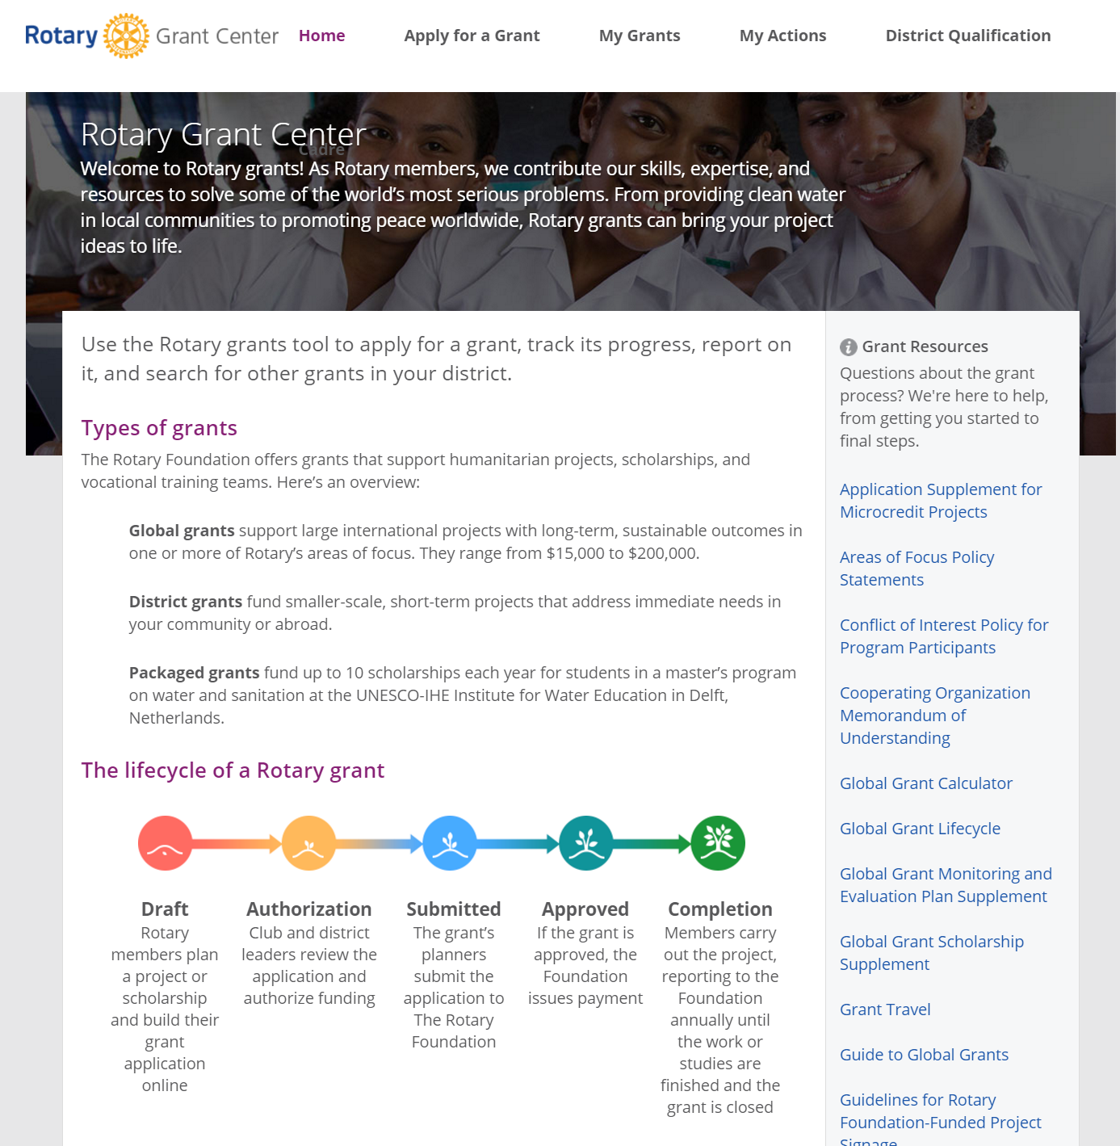
RESOURCES
www.rotary.org/myrotary
“Grants Center”
www.rotary2526.org
“TRF” “Resource Guide”
Notes:
We have a number of resources available to help you take full advantage of grant opportunities.
Rotary’s website has a wealth of general and detailed information about grants.
The learning center offers training resources to help you apply for Foundation grants.

Slide 87
TRF MOU SIGNING
WHO SHOULD SIGN THE TRF MOU?
Clubs applying for a District Grant for an international project in Mexico
Clubs who are a Primary Partner in a Global Grant
MOU must be signed by President (2019 – 2020) and President-Elect (2020 – 2021)
Notes:
Last fall the Trustees took two decisions that went into effect 1 January:
The Rotary Foundation will begin withholding tax from global grant scholarships awarded for study in the U.S. on any expenses beyond tuition, books, necessary equipment, and fees, except for U.S.-bound scholars from Japan, Canada, and Germany, who are funded through associate foundations in those countries.
Clubs and districts will be able to use global grants for the construction of low-cost shelters and simple schools, as long as the construction is part of a comprehensive project related to an area of focus. Project guidelines and application appendices for low cost shelters and simple schools are available on rotary.org.

Slide 88
HOW TO WRITE A GLOBAL GRANT
April 20, 2019
9 am – 12 pm
Janice Kurth DRFC District 5340
District Office
Sign up today on DACdb
Notes:
Last fall the Trustees took two decisions that went into effect 1 January:
The Rotary Foundation will begin withholding tax from global grant scholarships awarded for study in the U.S. on any expenses beyond tuition, books, necessary equipment, and fees, except for U.S.-bound scholars from Japan, Canada, and Germany, who are funded through associate foundations in those countries.
Clubs and districts will be able to use global grants for the construction of low-cost shelters and simple schools, as long as the construction is part of a comprehensive project related to an area of focus. Project guidelines and application appendices for low cost shelters and simple schools are available on rotary.org.

Slide 89
CONTACTS
District Rotary Foundation Committee Chair
Jim Paddock jpaddock1415@att.net
Grants Subcommittee Chair
Helen Maxwell helenrotary@2maxwells.com
District Grants Subcommittee Chair
Stacey Giannoulis rotarystacey@gmail.com
Global Grants Subcommittee Chair
International Service Chairs
John Perry jsprotary@gmail.com

Slide 90
Thank you!

