Slide 1

ROTARY DIRECT

Slide 2

THE ROTARY FOUNDATION : MISSION
World Understanding
Goodwill
Peace
Notes:
The mission of The Rotary Foundation is to Enable Rotarians to Advance, World Understanding, Goodwill, and Peace through the Improvement of Health, the Support of Education and the Alleviation of Poverty.
We accomplish this by fostering effective and sustainable projects around the world. We are looking to the future and incorporating projects within the 6 areas of focus bringing us closer to our mission while supporting the amazing work of Rotarians. Through OUR Foundation, we reach out to both our local and international communities enriching the lives of millions.

Slide 3
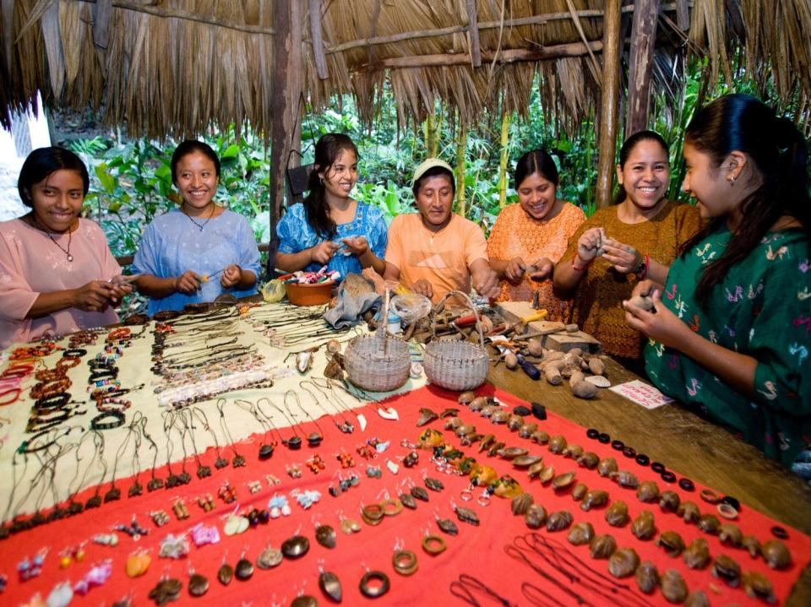
GRANTS
District Grants
Global Grants
Notes:
We do this by funding Rotarian’s humanitarian projects through three types of grants.
District grants are block grants that enable clubs and districts to address immediate needs in their communities and abroad.
Global grants offer clubs and districts opportunities to participate in strategically focused, high-impact activities. These grants fund large-scale international humanitarian projects, vocational training teams, and scholarships that have sustainable, measurable outcomes in one or more areas of focus.

Slide 4

AREAS OF FOCUS
Peace and Conflict
Prevention/Resolution
Disease Prevention and
Treatment
Water and Sanitation
Maternal and Child Health
Basic Education and
Literacy
Economic and
Community Development
Notes:
Global Grants fund projects that fall within one or more of Rotary’s Six Areas of Focus. These are:
-Peace and Conflict Prevention/Resolution
-Disease Prevention and Treatment
-Water and Sanitation
-Maternal and Child Health
-Basic Education and Literacy
-Economic and Community Development

Slide 5
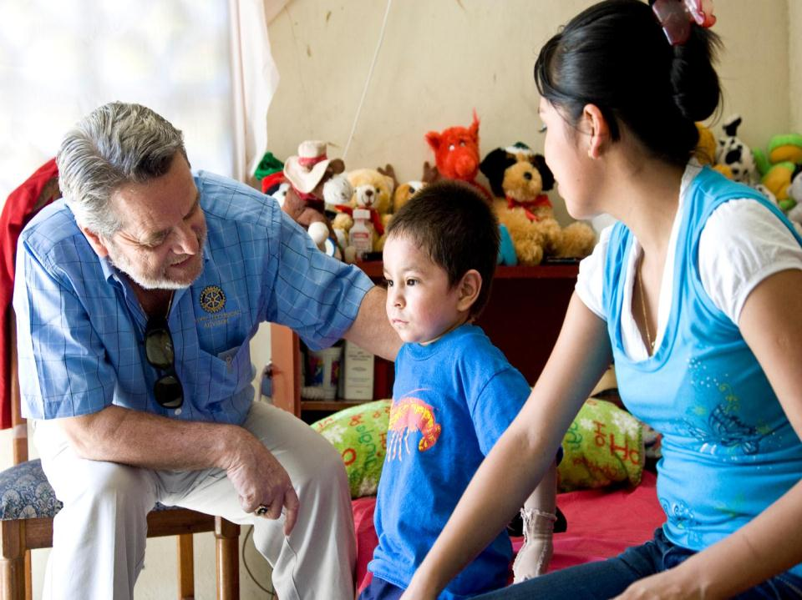
EREY : EVERY ROTARIAN EVERY YEAR
Notes:
The Rotary Foundation
-Addresses all of the greatest educational and humanitarian needs
-Its world reach is greater than the United Nations
-We can go where politicians and religious groups cannot
The Annual Fund is the primary source of funding for the programs of The Rotary Foundation. The Annual Fund is the cornerstone for these programs; for the beneficiaries, and why we give. It is for the stories these programs permit us to tell.
For us to continue doing so much good in the world, it is necessary for Every Rotarian to participate in the programs and to support our Foundation Every Year.
If Rotary is to be there to:
Teach children to read, build wells, feed the hungry, care for the sick, shelter the poor; then Every Rotarian is invited to support the Annual Fund with a personal contribution, Every Year.

Slide 6


ANNUAL FUND – SHARE
50% DDF
(District Designated Funds)
50%
World Fund
Notes:
Fifty percent (50%) of all Annual Fund – SHARE contributions come back to our district through District Designated Funds (DDF) in three years to spend on educational and humanitarian activities chosen by us; even grants that may be used for projects in our local community.
The other 50% goes to the World Fund and is used to fund other Foundation programs in which we can participate, and is the source of matching funds we receive from our Foundation to implement some of our international projects.
So the funds we have access to this year are a result of our contributions three years ago.

Slide 7
RECURRING GIVING : ROTARY DIRECT
Notes:
One of the best ways to support the Annual Fund is through the Foundation’s recurring giving option called Rotary Direct. Rotary Direct saves time, money, and lives through your generous contributions by allowing you to have a credit card or debit card charged on a monthly, quarterly or annual basis.

Slide 8

ROTARY DIRECT FOR PAUL HARRIS SOCIETY
US$ 84 monthly
US$250 quarterly
US$1,000 annually
Notes:
And you can show increased support by giving at a level to qualify for Paul Harris Society. Paul Harris Society is a recognition that recognizes individuals who commit to contributing $1,000 or more every year to the Annual Fund, PolioPlus or an Approved Foundation Grant. Rotary Direct makes fulfilling this commitment each year easy by allowing you to be charged a US$84 contribution each month.

Slide 9

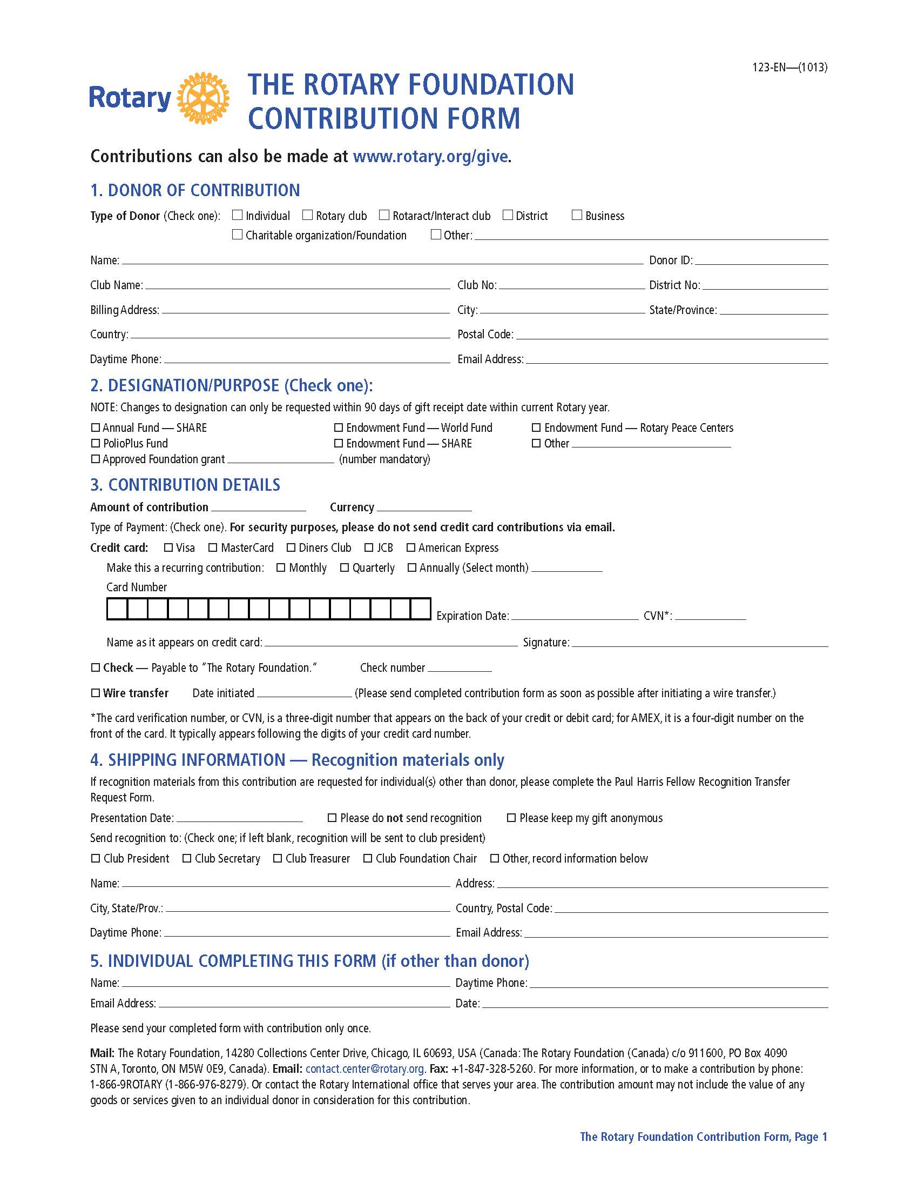
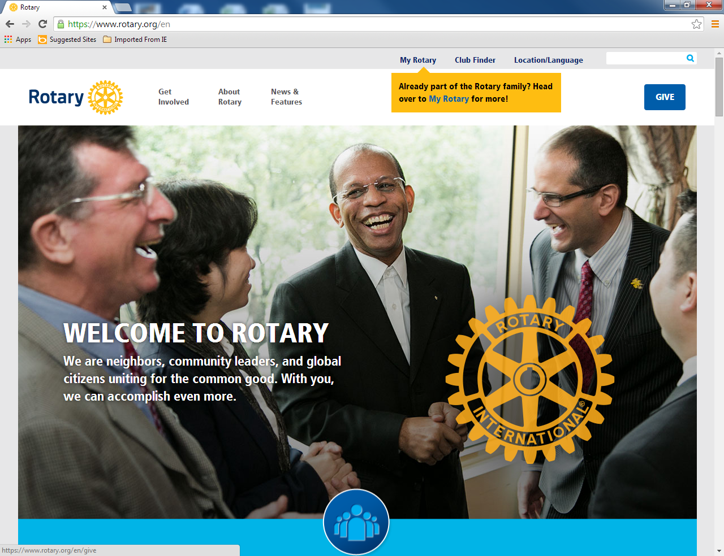
HOW TO SIGN UP
Contribute Online
Rotary Direct
Form
Contribution
Form
Notes:
Regardless of the recurring contribution amount you choose, Rotary makes it easy to sign up for Rotary Direct by providing the ability to sign up both online and using paper contribution forms.

Slide 10
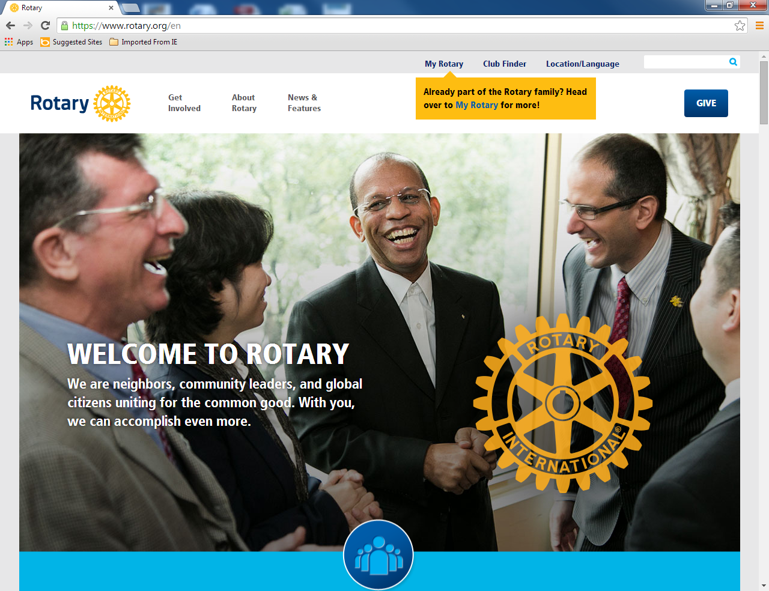
SIGN UP FOR ROTARY DIRECT ONLINE
Notes:
Let’s first look at the process for signing up online. To sign up online as a Rotarian, simply click the “Give” button on Rotary’s website.

Slide 11
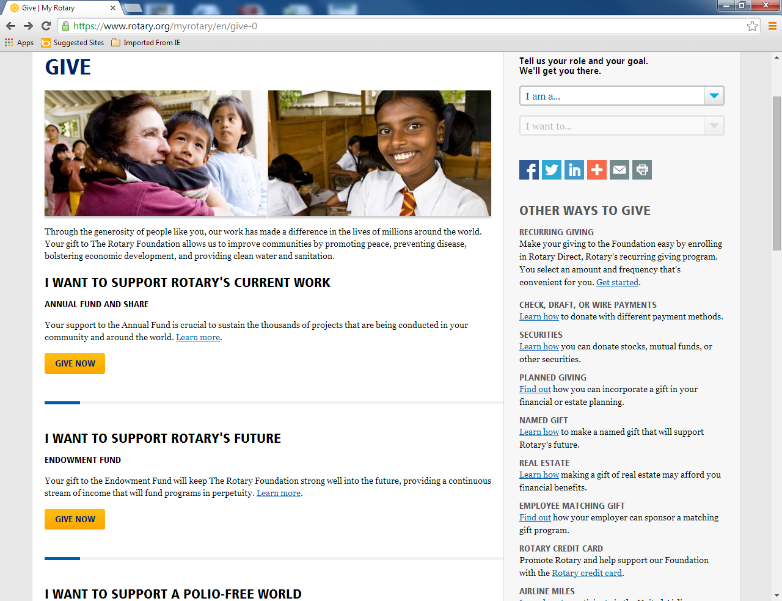
CHOOSE A GIFT DESIGNATION
Notes:
Once here you will choose the designation of your gift by clicking the “Give Now” button for your chosen designation.

Slide 12
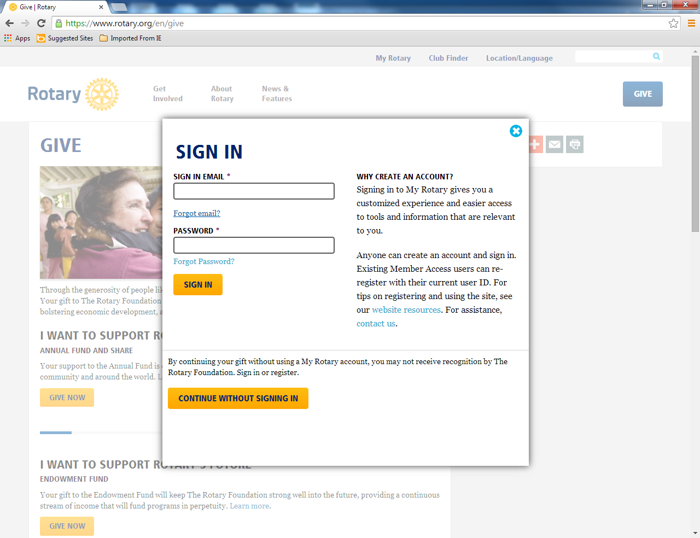
SIGN IN OR CREATE AN ACCOUNT
Notes:
Then sign in if you have an account or register to create an online account. Once signed in you may be asked to confirm your role if you hold various leadership roles within your club or district. If so, simply choose a role and continue.

Slide 13
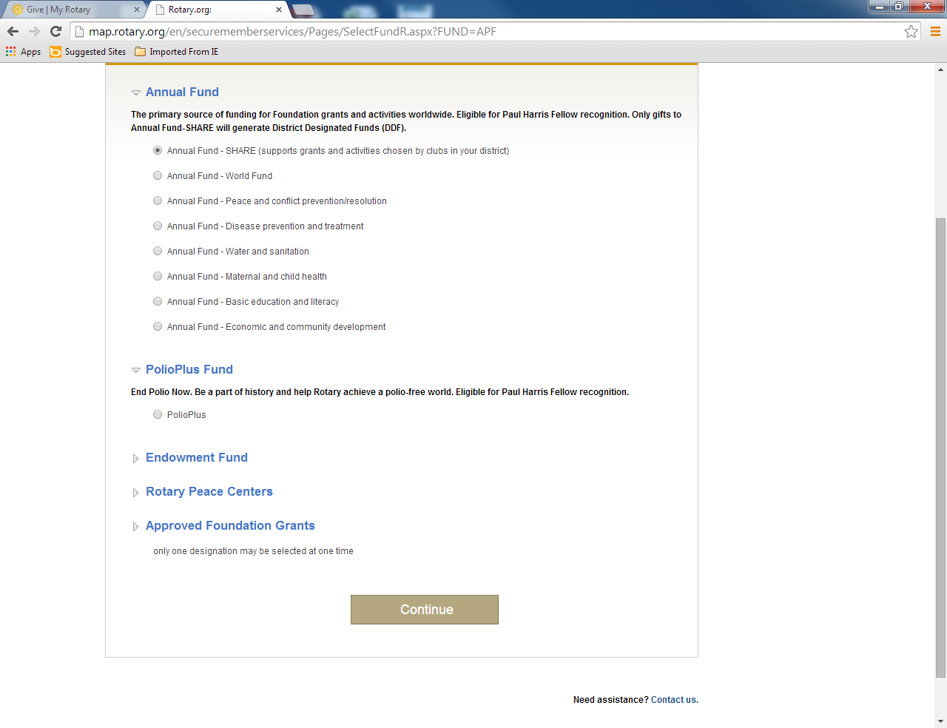
CHOOSE DESIGNATION DETAILS
Notes:
You can then choose your specific fund designation. Keep in mind that for Annual Fund giving, Annual Fund – SHARE is the only designation that supports grants and activities chosen by clubs in your district.

Slide 14
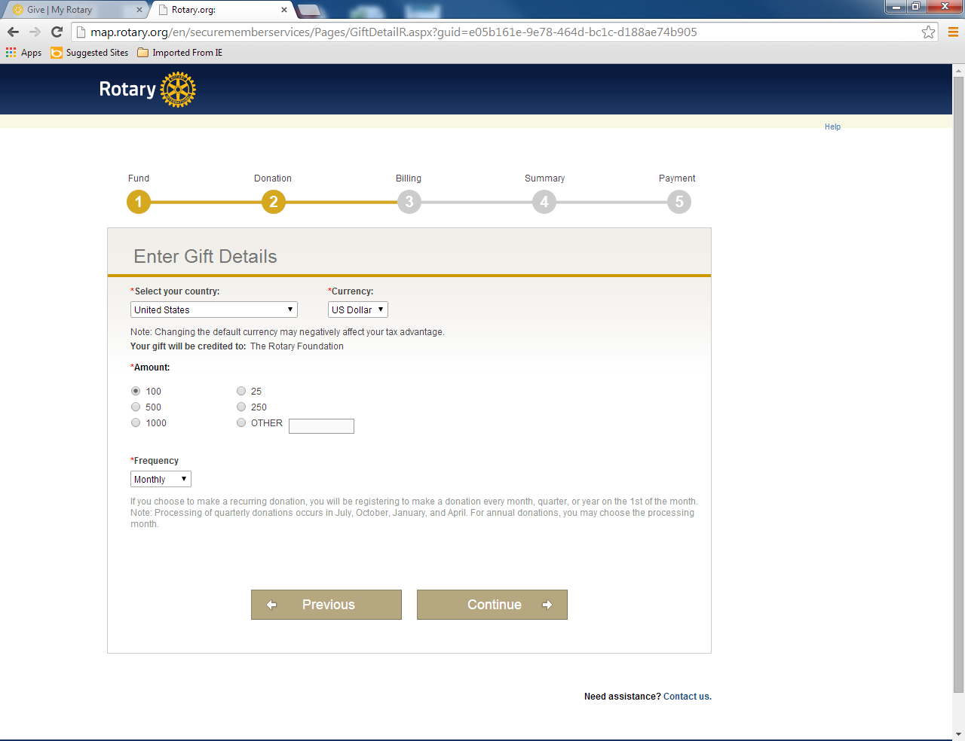
ENTER GIFT DETAILS
Rotary Direct
Notes:
On the Gift Details page complete information such as the contribution amount. Then simply choose the frequency from the drop-down menu. You will then continue to the billing screen where you can enter your payment information.

Slide 15
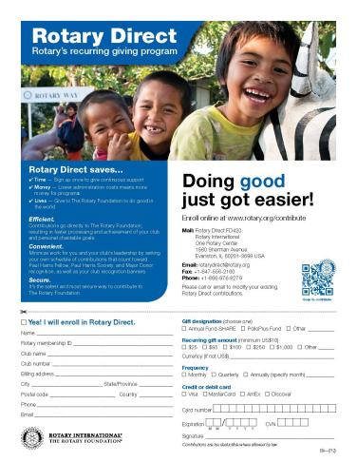
SIGN UP BY MAIL
Download from rotary.org
Notes:
If you prefer to sign-up by mail you can use either the Rotary Direct paper form or the Foundation’s standard contribution form, both of which can be downloaded from Rotary.org.

Slide 16
“Rotary is a great value. It changes the course of human
life. It changes the life of every Rotary beneficiary, as
well as the life of each Rotarian”
- Richard D. King, Past RI President, 2001-02
Notes:
As past RI President, Rick King once said, “Rotary is a great value. It changes the course of human life. It changes the life of every Rotary beneficiary, as well as the life of each Rotarian.”
Thank you for all you do to change lives throughout the world. Please consider enrolling in Rotary Direct so that your annual support will continue to change the lives of so many each and every year.

